Slide 1
Implementation Design Approach presentation
SA00570532
Aashiq Ahamed SP
Project 2 – Azure DevOps

Slide 2
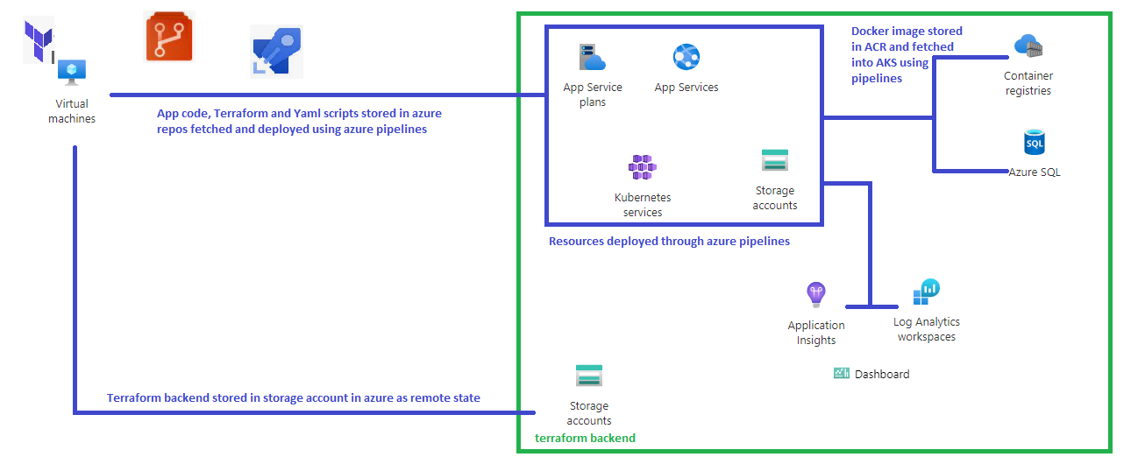
Azure resources and tools used for this project

Slide 3
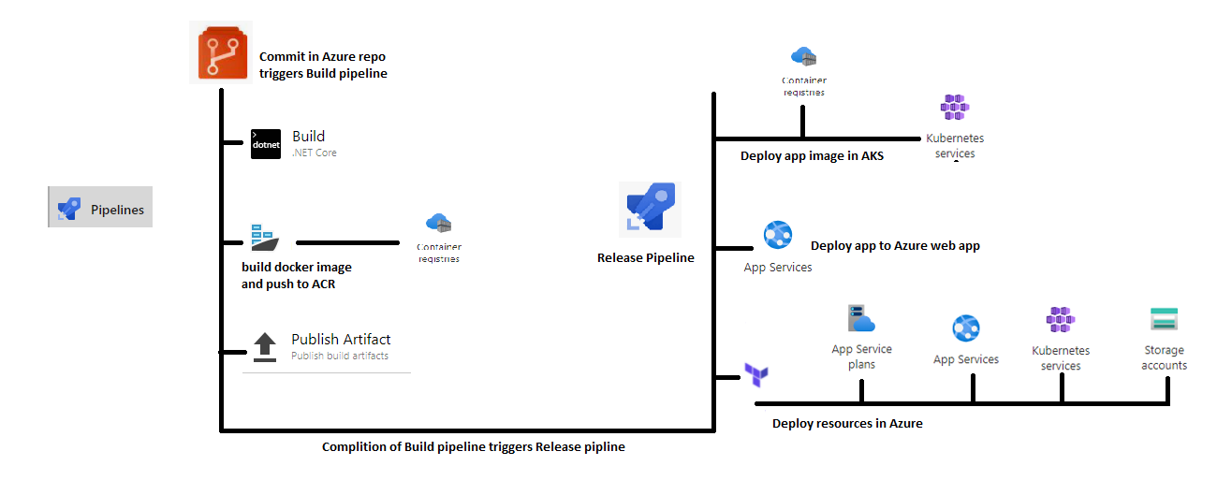
Azure pipelines

